Slide 1
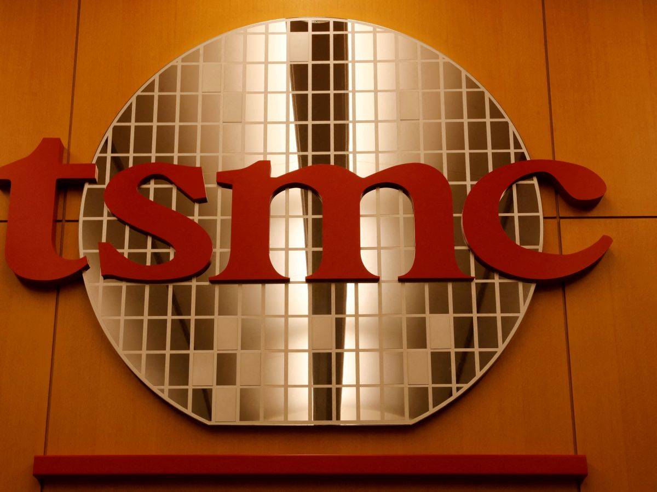
Team 3 TSMC
Team Members
Akanksha Telegam Setty 002131614
Pramod Gopal 001586157
Vishesh Gupta 001549234
Kshitij Zutshi 001021288
Kashish Naresh Santani 002102203
Rui Tang 001002863

Slide 2
Background

Slide 3
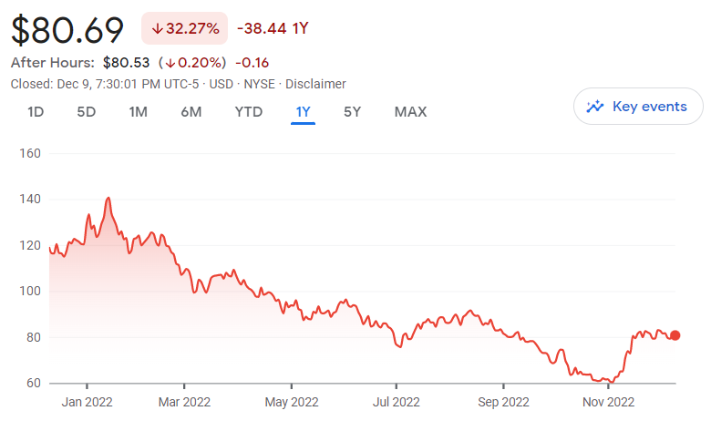
Background
TSM is the First Taiwan Company to be listed on NYSE on October 8, 1997(9:30 am New York time)
The all-time high Taiwan Semiconductor Manufacturing stock closing price was 138.47 on January 14, 2022.
The Taiwan Semiconductor Manufacturing’s 52-week high stock price is 145.00, which is 75.4% above the current share price.
The Taiwan Semiconductor Manufacturing 52-week low stock price is 59.43, which is 28.1% below the current share price.
The average Taiwan Semiconductor Manufacturing stock price for the last 52 weeks is 94.18
Taiwan Semiconductor Manufacturing’s market cap as of December 01, 2022, is $428.81B

Slide 4
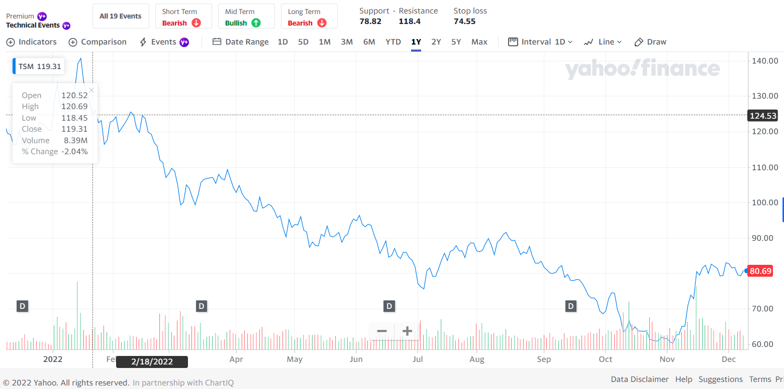

March 3rd, 2022:
TSMC share price drops low as Ukraine conflict continues
November 15th, 2022:
TSM Stock Surges After Warren Buffett Takes Big Stake In Chipmaker

Slide 5
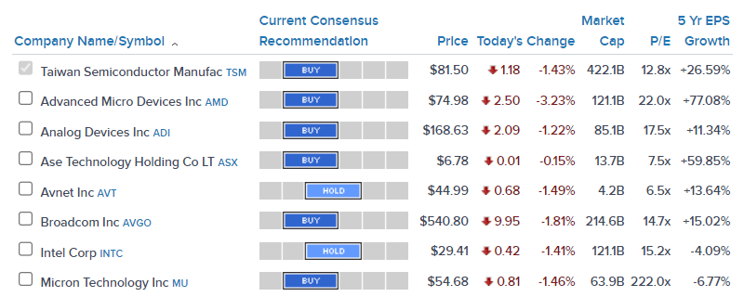
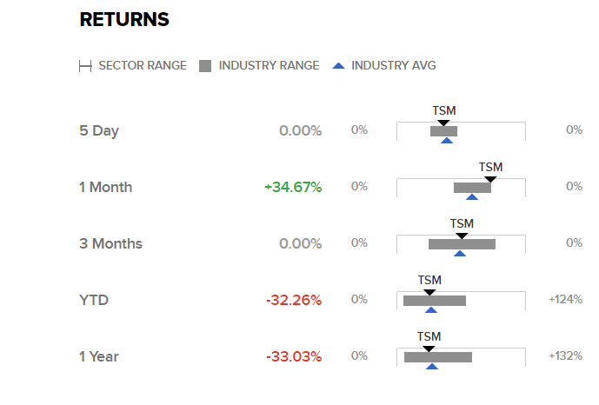
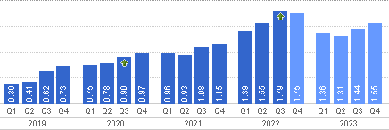
Top 10 Peers
Earning Projections

Slide 6
EDA

Slide 7
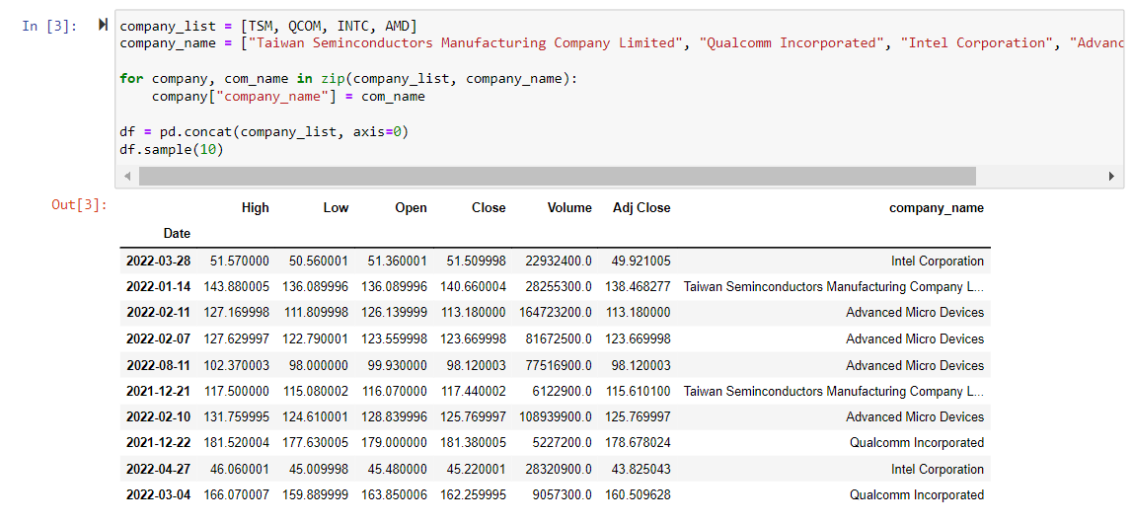
Exploratory Data Analysis

Slide 8
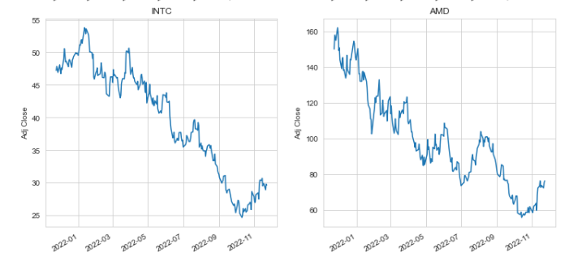
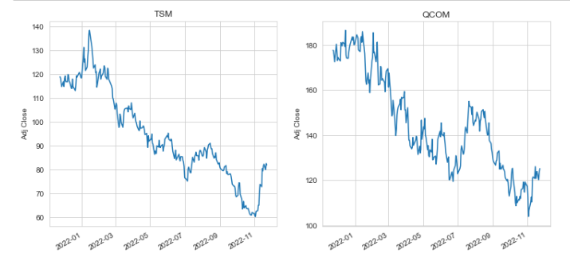
Adjusted Close of TSMC, Qualcomm, Intel and AMD

Slide 9
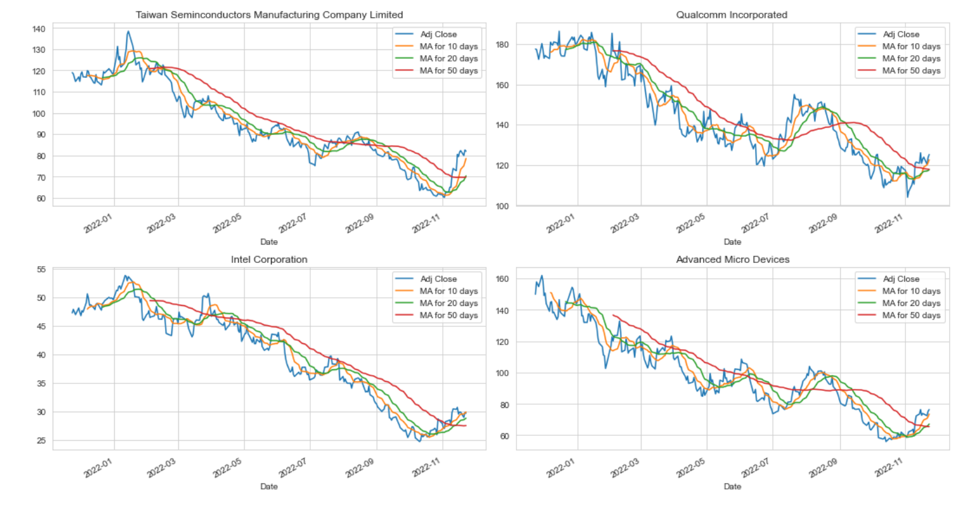
Adjusted Close and Moving Average of TSMC, Qualcomm, Intel and AMD

Slide 10
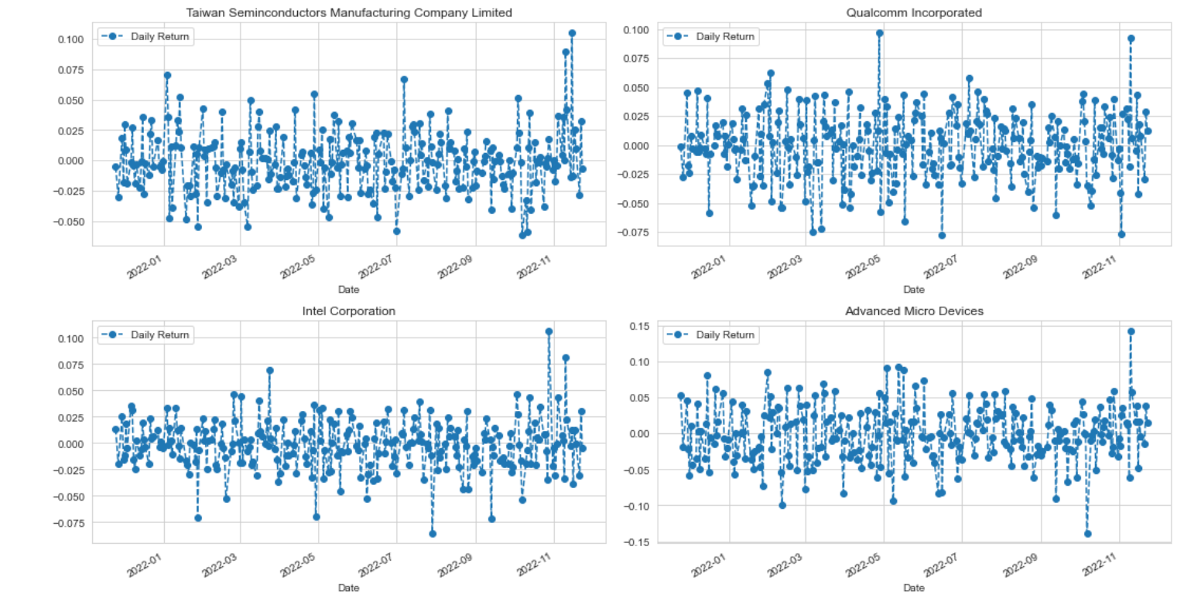
Daily Returns of TSMC, Qualcomm, Intel and AMD

Slide 11
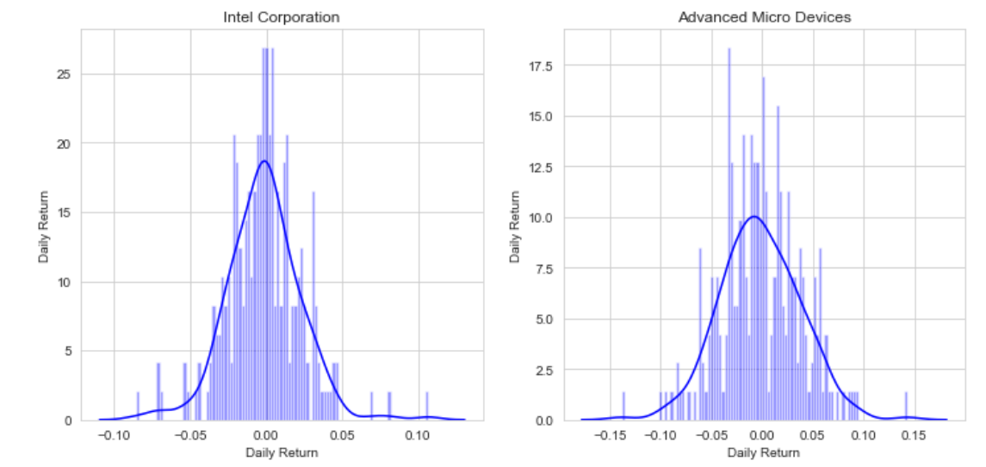
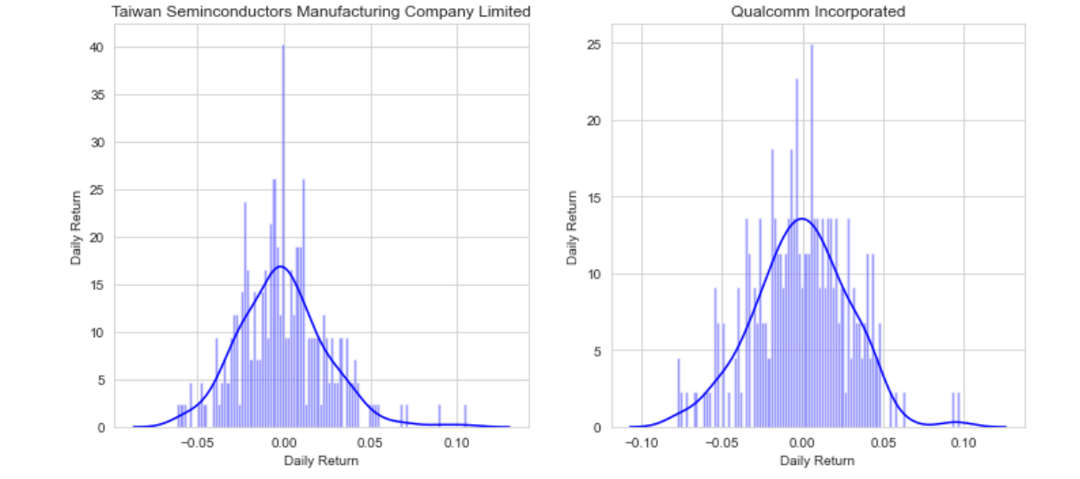
Distribution of Daily Returns - TSMC, Qualcomm, Intel and AMD

Slide 12
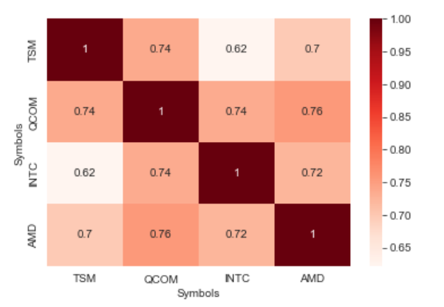
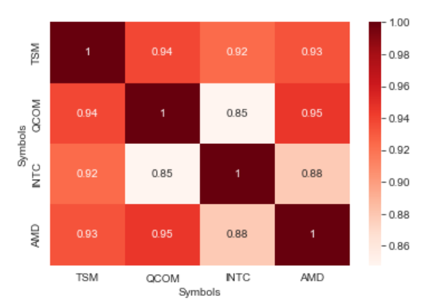
Heat Maps for TSM & it’s competitors

Slide 13
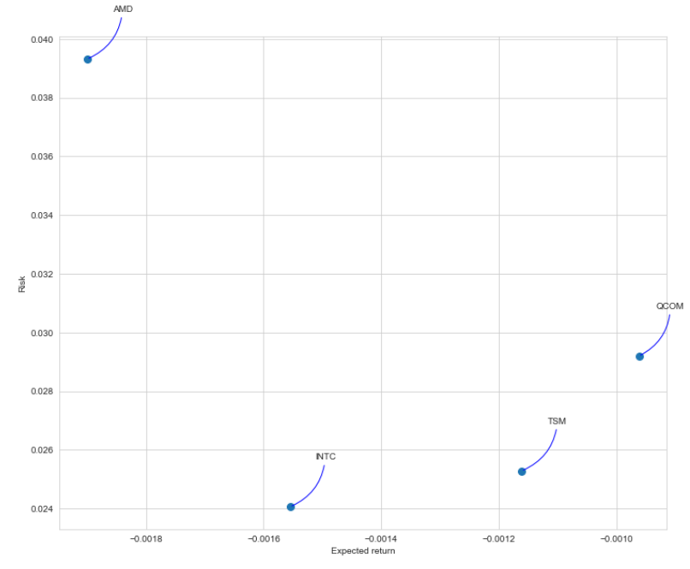
Risk Vs. Return - TSMC & Competitors​

Slide 14
Modelling

Slide 15
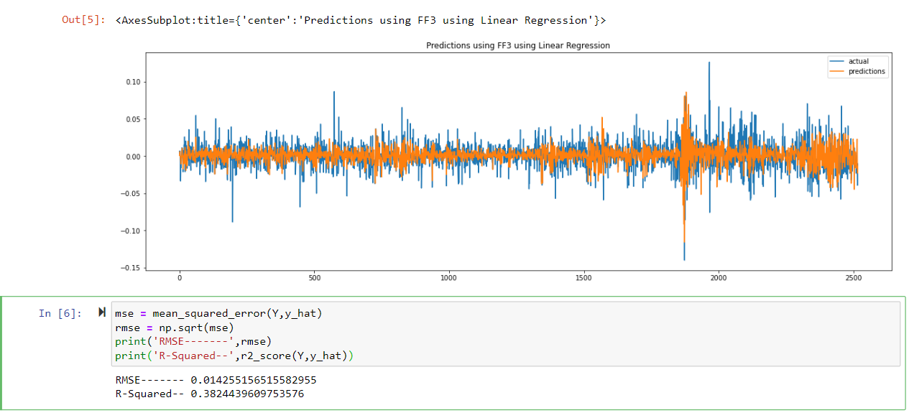
FAMA French 3 Factor Model - Regression

Slide 16
The FAMA and French Three Factor model highlighted that investors must be able to ride out the extra volatility and periodic underperformance that could occur in the short term.
Investors with a long-term time horizon of 15 years or more will be rewarded for losses suffered in the short term.
The main factors driving expected returns are sensitivity to the market, sensitivity to size, and sensitivity to value stocks, as measured by the book-to-market ratio. Any additional average expected return may be attributed to unpriced or unsystematic risk.
3 Factors of this model are:
SMB (small minus big)
HML (high minus low)
The portfolio's return less the risk-free rate of return​

Slide 17
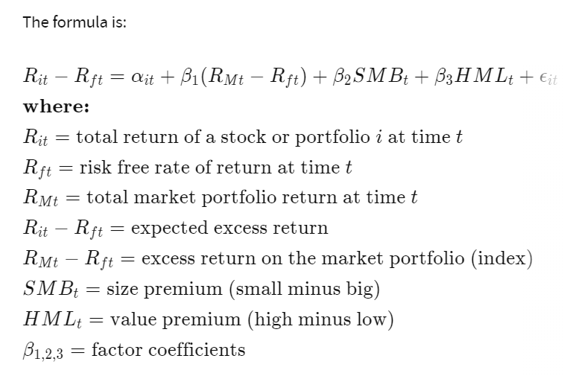

Slide 18
ML MODELS
LSTM
Ridge Regression
Kalman Filters
Garch Model
FAMA Factors with Regression

Slide 19
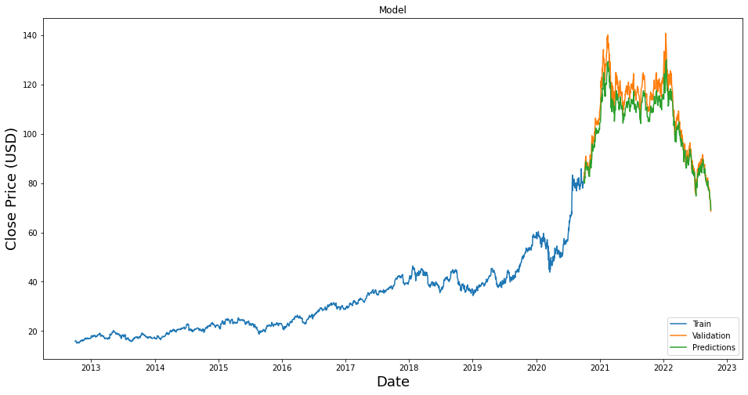
LSTM & Ridge Regression
Long Short-Term Memory network (LSTM) is a kind of time cyclic neural network, which is specially designed to solve the long-term dependence problem of common RNN (recurrent neural network).
All RNN have a chain form of repetitive neural network module. In standard RNN, this repetitive structural module has only a very simple structure, such as a tanh layer.

Slide 20
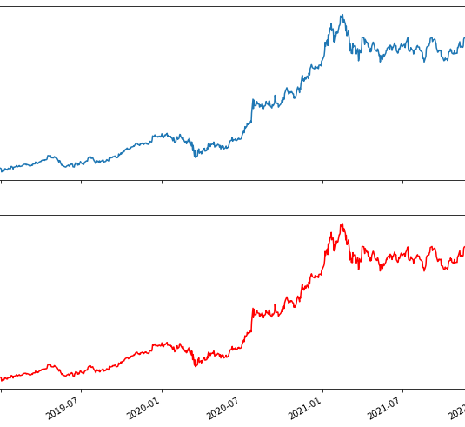
Ridge regression is a biased regression method dedicated to the analysis of collinear data. It is essentially an improved least squares estimation method.
By giving up the unbiased nature of the least squares method, At the cost of losing part of the information and reducing the accuracy, the regression coefficient is more in line with the reality and more reliable regression method, and the fitting of ill-conditioned data is better than the least square method.

Slide 21
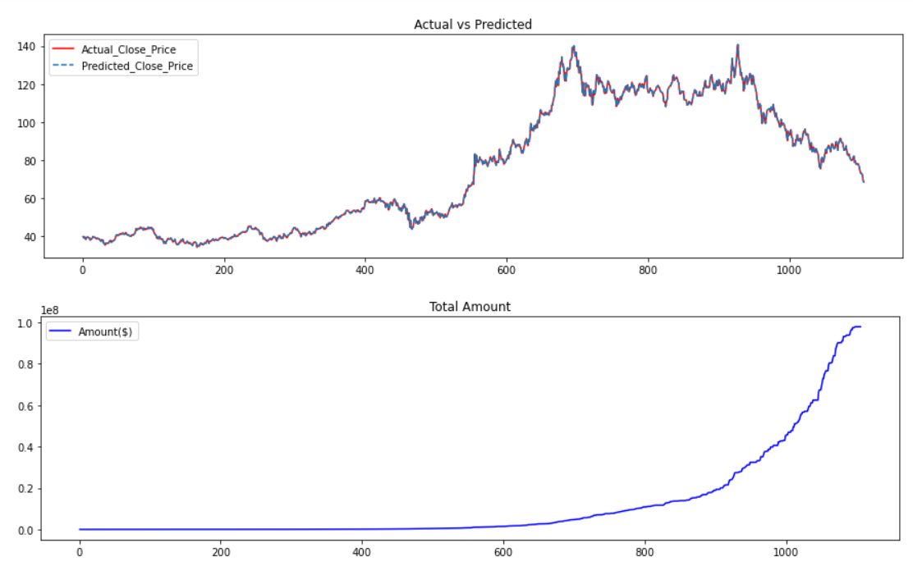
Ridge Regression

Slide 22

Inference for LSTM
R-Squared Score = 0.831464077449926​
LSTM modeling gave good results when trained on the last decade's data and ran validation on the last 2 years​

Slide 23
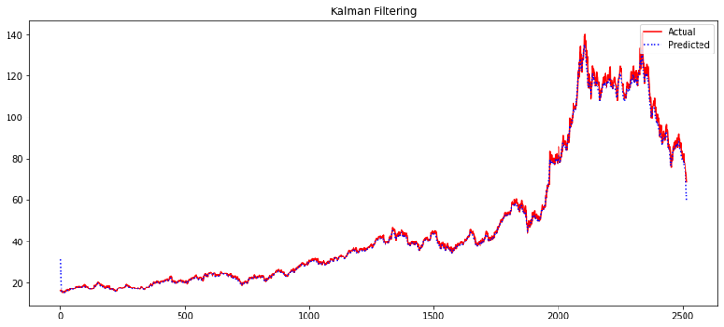
Kalman filters
Kalman Filter implemented on TSM ticker for the duration of 09/30/2012 to 09/30/2022

Slide 24
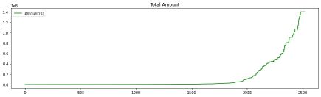
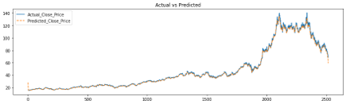
Kalman Filter Buy/Hold Trading Strategy​
Buy if we have next day's predicted value greater than today's close value and hold if already bought.
Sell if we have next day's predicted value lesser than today's close value and don't buy until rule 1​
​
Model Metrics -​ ​ R2 Score : 0.9978352645121594​

Slide 25
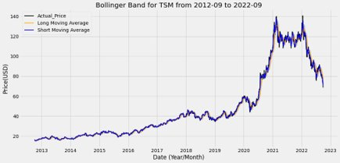
Kalman Filter Buy/Hold Trading Strategy with Bollinger Bands
Trading Bollinger bands are used to infer how high high/low the prices are on a relative basis​
It’s a technical indicator calculated based on the standard deviation of a simple moving average (average price over the specified period)​
​
​
Model Metrics -​ ​ R2 Score : 0.9978352645121594​

Slide 26
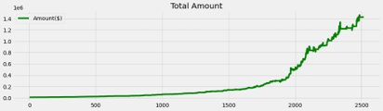
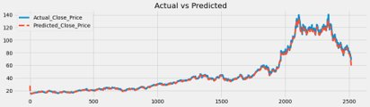
Kalman Filter Buy/Hold Trading Strategy with Bollinger Bands​
Trading Bollinger bands are used to infer how high high/low the prices are on a relative basis​
It’s a technical indicator calculated based on the standard deviation of a simple moving average (average price over the specified period)​
​
Strategy test - ​
Initial Investment : 1009590.0​ Final Amount: 1425716.0 $​ Profit Percent latest trading year: 41.22 %​

Slide 27
Moving Average Strategy
SMA calculates the average price stock for a period without giving any preference to specific data​
EMA calculates average giving more weight to current data; newest price has more impact compared to older price ​
Simple Moving Average Exponential Moving Average​

Slide 28
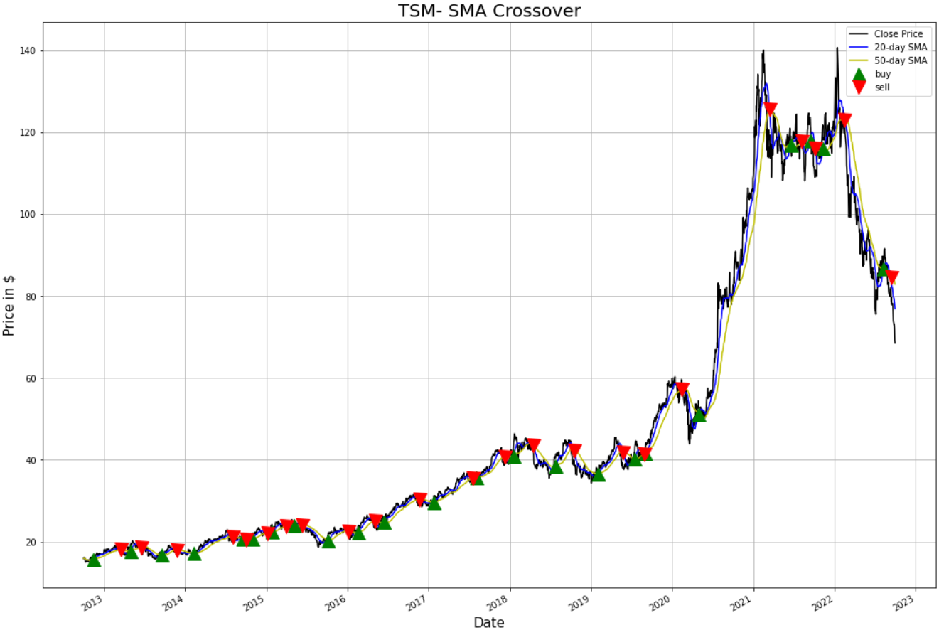
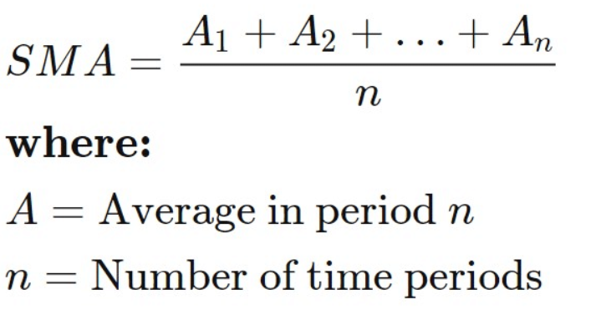
Simple Moving Average​
Implemented on TSM ticker from 09/30/2012 to 09/30/2022

Slide 29
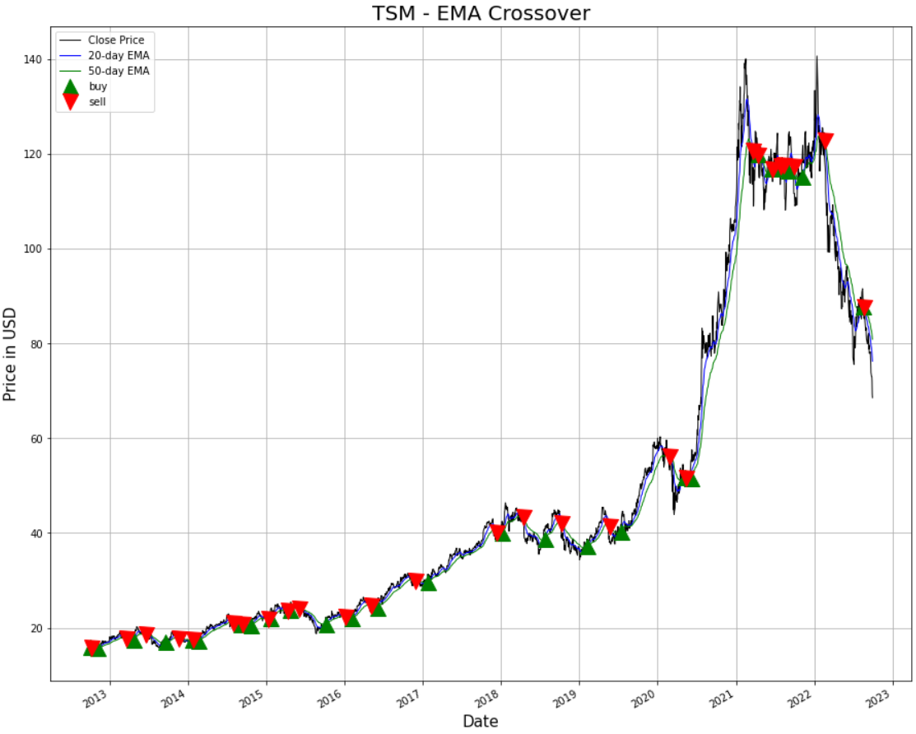
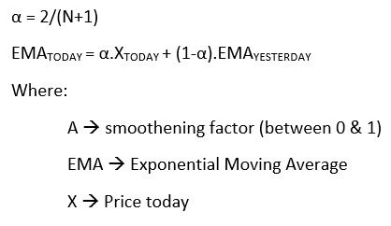
Exponential Moving Average​
Implemented on TSM ticker from 09/30/2012 to 09/30/2022

Slide 30

Key Takeaway
Moving Average act as a support for the market trend
EMA is more sensitive to price change compared to SMA
SMA is used in conjunction to EMA to reduce false trend signals
EMA can act as a form of support or resistance

Slide 31
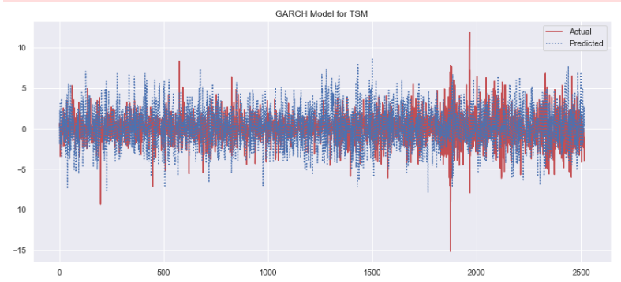
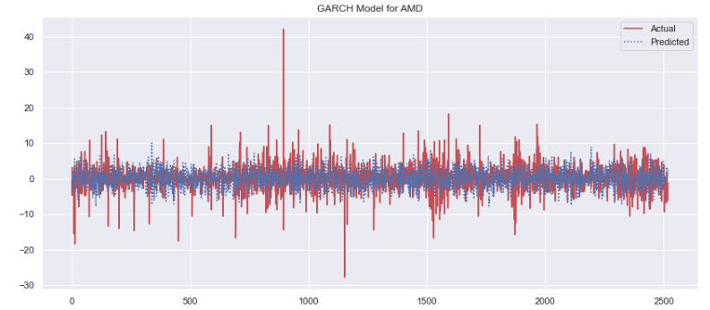
Garch model
GARCH model is a regression model specially customized for the volume of financial data.
Apart from the common regression model, GARCH further modeled the variance of the error.
Especially applicable to the analysis and prediction of volatility, such analysis can play a very important guiding role in the decision-making of investors, and its significance in many cases exceeds the analysis and prediction of the value itself.

Slide 32
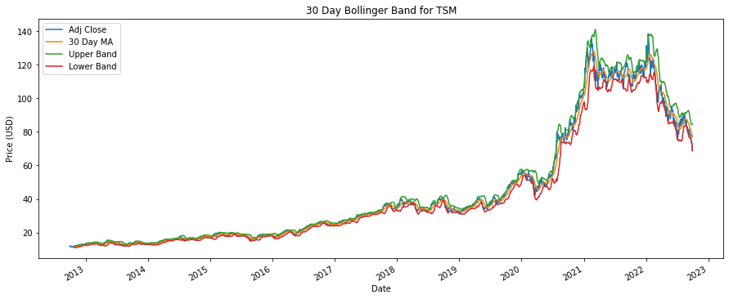
Bollinger Bands
Bollinger Bands represent a key technical trading tool for financial traders. Bollinger bands are plotted by two (2) standard deviations (a measure of volatility) away from the moving average of a price. Bollinger Bands allow traders to monitor and take advantage of shifts in price volatilities. This provides a 95% confidence interval that shows the predicted price will face under the given interval.
Main Components of a Bollinger Bands
Upper Band: The upper band is simply two standard deviations above the moving average of a stock’s price.
Middle Band: The middle band is simply the moving average of the stock’s price.
Lower Band: Two standard deviations below the moving average is the lower band.

Slide 33


Conclusion
Model | Strategy
FAMA Factors with Regression
LSTM
Ridge Regression
Kalman Filter
Garch Model

Slide 34

Thankyou!

